Slide 1


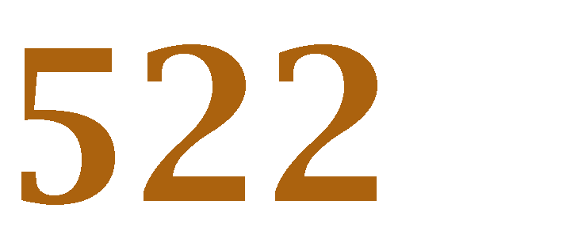


Lecture 07 – SVM parameters

Slide 2


Classification
2
Data acquisition and preprocessing
Feature Extraction
Feature Selection
Train the model
Test and use the model to make the prediction

Slide 3












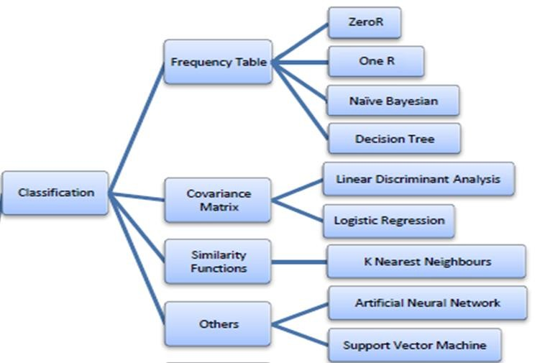


3
Classification is a data science task of
the value of a
(target or class) by building a model based on
or
and/or
■
main groups of classification algorithms are:
Frequency Table
Covariance Matrix
Similarity Functions
Others

Slide 4

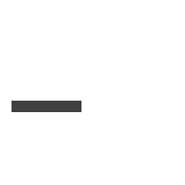




List of Classifiers
4
■
■
■
■
■
■
Etc.

Slide 5






How Classification Works
5
Classification Algorithm
Training Data
CS garde | Result
5 | Fail
6 | Pass
2 | Fail
7 | Pass
9 | Pass
Classifier Model
If CS ≤ 5 Then Result = Fail
PASS
Test Query
CS = 8, Result = ?

Slide 6











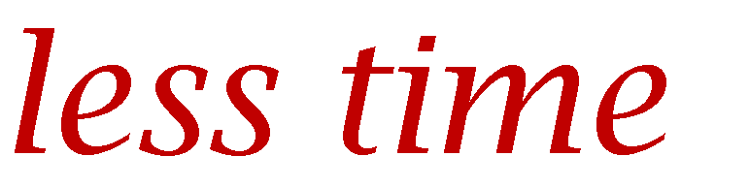


Type of Learner
6
Eager Learner
■
from training dataset is constructed.
, the of test dataset is .
, eager learners take a
Using the
Due to the
.
and
Example:
Decision Tree
Naive Bayes
Artificial Neural Networks

Slide 7
instance-based learning - lazy learners .
7
Lazy Learner
Training dataset is stored.
On querying similarity between test data and training set record is calculated to predict the class of test data.
Compared to eager learners, lazy learners have less training time but more time in predicting
Example:
k-nearest neighbor,
Case-based reasoning

Slide 8
Supervised Learning
8
Parametric supervised learning
A parametric algorithm has a fixed number of parameters.
A parametric algorithm is computationally faster but makes stronger assumptions about the data; the algorithm may work well if the assumptions turn out to be correct, but it may perform badly if the assumptions are wrong.
Example: Linear Support Vector Machines, Perceptron, Logistic Regression.

Slide 9
Supervised Learning
9
Non-parametric supervised learning
A non-parametric algorithm uses a flexible number of parameters, and the number of parameters often grows as it learns from more data.
A non-parametric algorithm is computationally slower but makes fewer assumptions about
the data.
Non-parametric methods are good when you have a lot of data and no prior knowledge.
Example: K-nearest neighbor, Decision Trees, Artificial Neural Networks, Support Vector
Machines with Gaussian Kernels.

Slide 10
Support Vector Machine Classifier
What is Support Vector Machine?
How does it work?
How to tune Parameters of SVM?
Types of SVM
Pros and Cons of SVM
Applications of SVM
February 21, 2022

Slide 11
Basic Notations
25
Name | Notation
Input Space | x ∈ X
Output Space | y ∈ Y = { -1, + 1}
Hypothesis | h ∈ H
Real-Valued | f : X →R
Training Set | S = {(x₁,y₁), ……(x_{i},y_{i})}
Test Error | ε

Slide 12











Support Vector Machine (SVM)
26
Support Vector Machine(SVM) is a technique used for
.
SVM can also be used for learning and is known as
.
that are then into that
categorized based on which side of the gap they fall.
can then be
A Support Vector Machine (SVM) is a discriminative classifier which intakes training data (supervised learning), the algorithm outputs an optimal hyperplane which categorizes new examples
The goal of SVM is to find the optimal separating hyperplane which maximizes the margin of the training data.

Slide 13





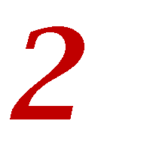


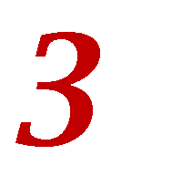




What is Support Vector Machine?
27
In two-dimensional space this hyperplane is a line dividing a plane in two parts
where in each class lay in either side.
dataset, a |  | represents the | .
dataset, a | is a | .
dataset, a | is a | .
And in the |  | , it is called a | .
x
x
x x
x
x
x
x x
x
x x
o
o
Separation of classes.
o
o
x
Y
x
Y
x
o
x
o
o
o
o
o
X
X
February 21, 2022

Slide 14



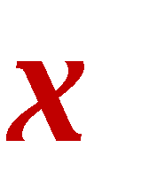





SVM , and our data has two features: |  |  | x x | x x | x x |  |  |  | 28
We want a classifier that, given a pair of coordinates, outputs if it’s either red or green | Y | o o | o o | o | x | x
X
A support vector machine takes these data points and outputs the hyperplane (which in two dimensions it’s simply a line) that best separates the tags.
x x
x
x
x x
Y
o o
x
o
x
This line is the decision boundary: anything that falls to one side of it we will classify as green, and anything that falls to the other as red.
o
o
X

Slide 15





Identifying the Hyperplane
30
w x + b ≥1 w x + b=0 w x + b ≤ -1
represents ^{x}
represents o
x
x
■
x
x x
x
Support
Vectors
And
Y
o
x
x
Plot each feature as a point in n-dimensional space.
o
o
o
Build hyperplane with maximum margin
o
Margin
Hyperplanes
SVM is the one that maximizes the margins from both tags.
X
A hyperplane is a linear decision surface that splits
the space into two parts in binary classifier.
There will never be any data points inside the margin

Slide 16



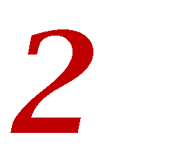


How does it work?
31
Identifying the right hyper plane.
■
.
■

Slide 17











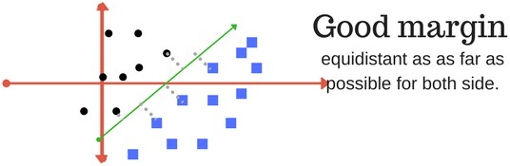
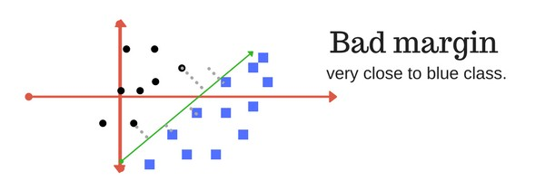
Margin
32
A margin is a
of to the
is one where this
.
A
for
the

Slide 18










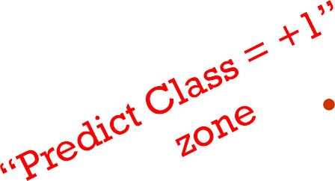
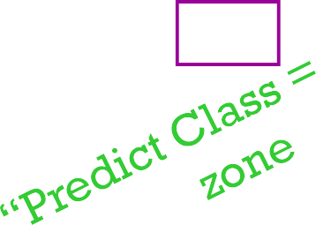

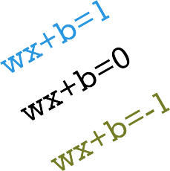
Margin
33
Margin is the
(on both sides)
between the
and the
The line (hyperplane) with
is termed as
The closest points where the margin distance is calculated are considered as the
.
Margin is maximized
_{x}+
Maximum margin Decision
hyperplane
_{X}-

Slide 19


Linear Classifiers
How would you classify this data?
34
Define the margin of a linear classifier as the width that the boundary could be increased by before hitting a datapoint.
x denotes +1
o denotes -1
x
x
x
x
x
x x
x
x x
x
x
o
x
Y
o
x
x
x
Y
o
o
o
o
o
o
o
o
X
X
Linear Function to separate two classes: f(x) = sign(w x + b)

Slide 20

Linear Classifier
35
How would you classify this data?
x
Misclassified
to +1 class
x
x denotes +1
o denotes -1
o
x
x x
x
Y
o
x
x
o
o
o
o
X
f(x) = sign(w x + b)
One green dots also fall in category of red
Data separation is not perfect
It tolerates some outliers in the classification

Slide 21









Nonlinear SVMs
36
Datasets that are
work out great:
0
x
But what if the
?
0
x
We can map it to a
:
_{x}2
0
x

Slide 22
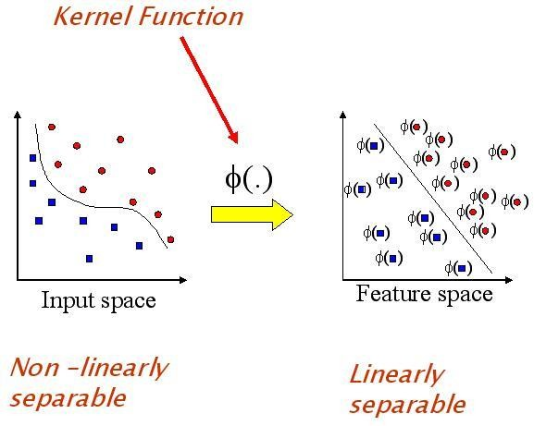
















Kernel
37
is | a | that | the to a | where the | is
Kernels be | in | . | to a | where the | can

Slide 23
Non-linear SVMs: Feature spaces
38
General idea: The original input space can always be mapped to some higher- dimensional feature space where the training set is separable:
Φ: x → φ(x)

Slide 24
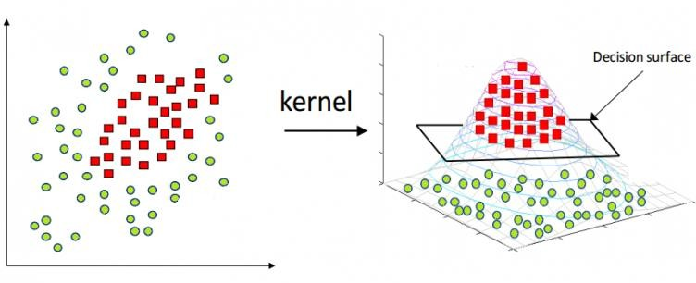
Kernel Methods
39

Slide 25











Non-Linear SVM
40
: | instead | of | the
φ(x), |  |  | such that
K(x_{i} , x_{j}) = φ(x_{i} ) · φ(x_{j})
This gives a in the original feature space:
i

Slide 26
Non-linear SVMs: Feature spaces
41
Name | Representation
Linear SVM | x_{i} . x_{j}
Non-Linear SVM | φ (x_{i} ) . φ(x_{j} )
Kernel function | k (x_{i} . x_{j} )

Slide 27
 | Types of Kernel Method
Name | Equation | Properties
Linear Kernel | k(x, x´) = x^{T}x´ | linear
Polynomial kernel | k(x, x´) = (1 + x^{T}x´)^{d} for any d > 0 d is the degree of the polynomial كثيرة الحدود | Popular in Image Processing
Gaussian kernel | k(x, x´) = exp (−||x − x´||²/2σ² for σ > 0 | no prior knowledge about the data
Radial basis function (RBF) | f(x) = σ^{𝑁} α 𝑦 exp (- || x – x ||² /2σ² ) + b 𝑖 𝑖 𝑖 i | Widely used kernel method. Suitable if no prior knowledge about the data
42
February 21, 2022

Slide 28







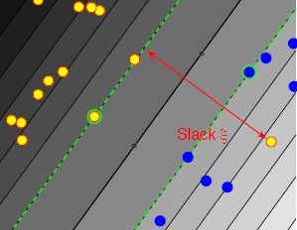





















Non-Linear Data
43
SVMs | are |  | by |  | the | , which is
the |  | of |  | between the |  | and
the If the |  |  | . |  |  | , though, there is
and so there's
"
" SVM solution.
This is why the "
" SVM was introduced,
.

Slide 29





































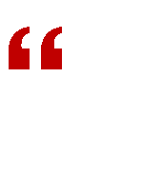


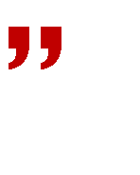

Slack Variable (ξ)
44
Many datasets will
.
As a result, there will |  | .
One way to cope with such datasets and still of the constraints by introducing | . | us ful is to | some
Slack variables are introduced |  | .
That is, certain training points will be allowed |  | .
We want the number of points within the course we want their |  | to be as . | , and of
To this end, we introduce a slack variable ξ
, one for each datapoint i. (ξ

Slide 30









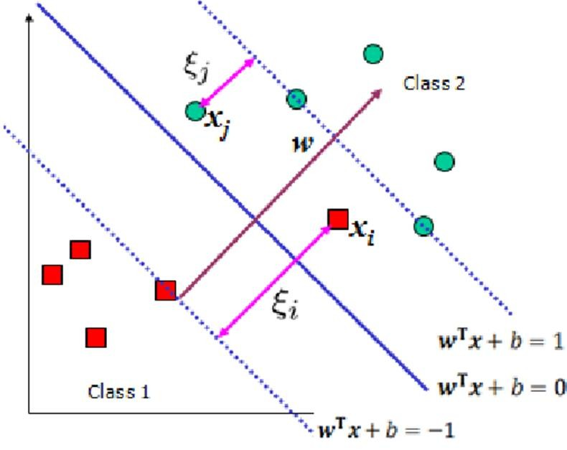










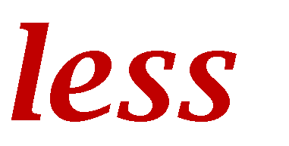






Slack Variable (ξ)
46
defining
.
ξ_{i} is the
, the point was
.
If ξ
and by
If it's between but by
, the point was than the SVM
If it's
, the point was
.
we aim to both maximize the margin and minimize violation of the margin constraints.

Slide 31
Tuning parameters of SVM
47
Kernel
Regularization (Lambda) (C)
Gamma
Epsilon (insensitive loss function)

Slide 32
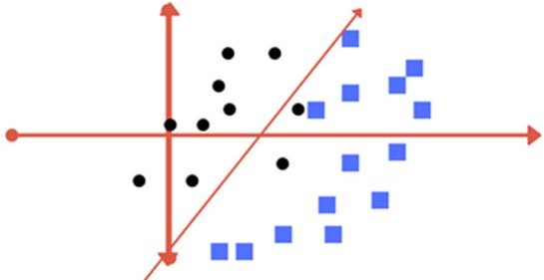
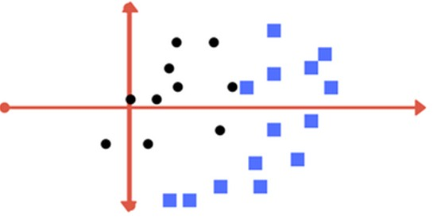
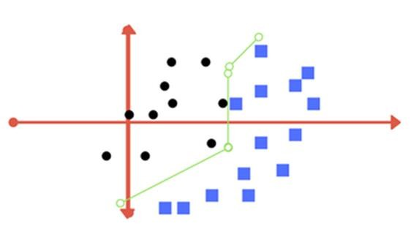
Regularization Parameter
48
Tolerates some outlier points
The separator provides the best classification
But its difficult to train a model like this
This term is known as Regularization parameter
Trying to achieve 0 tolerance with perfect partition

Slide 33

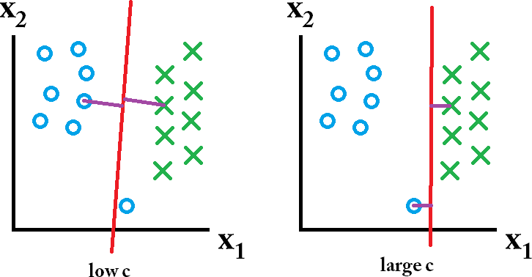

Regularization-c
49
SVM tends to achieve
■
■
The problem is that
The parameter determines
.
A lower C gives higher error on the training set, but finds a larger margin that might be more robust
Neglect it as error

Slide 34
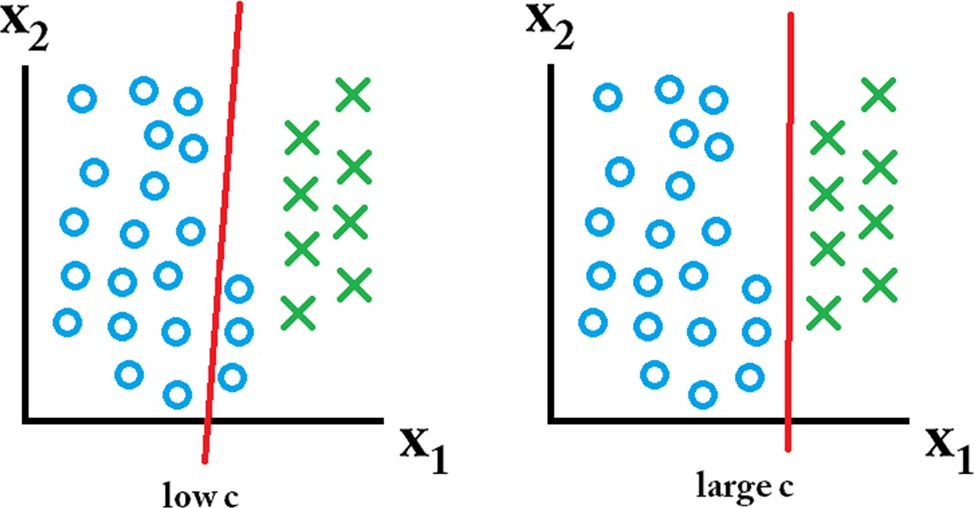
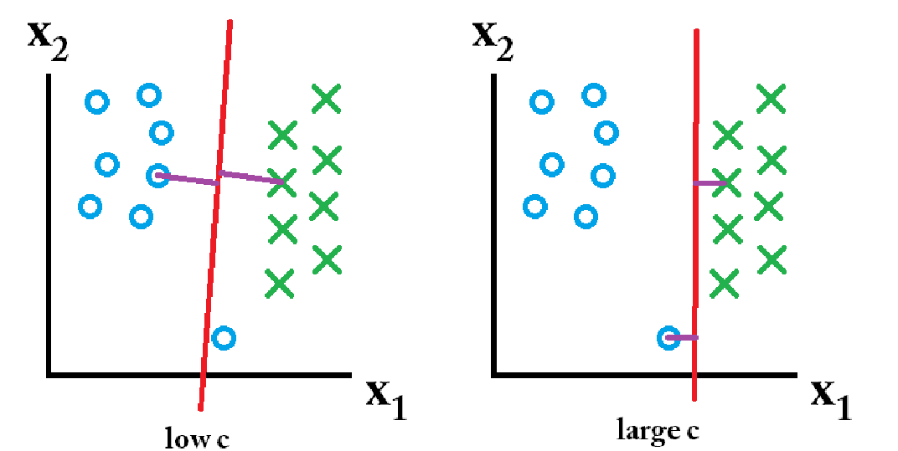


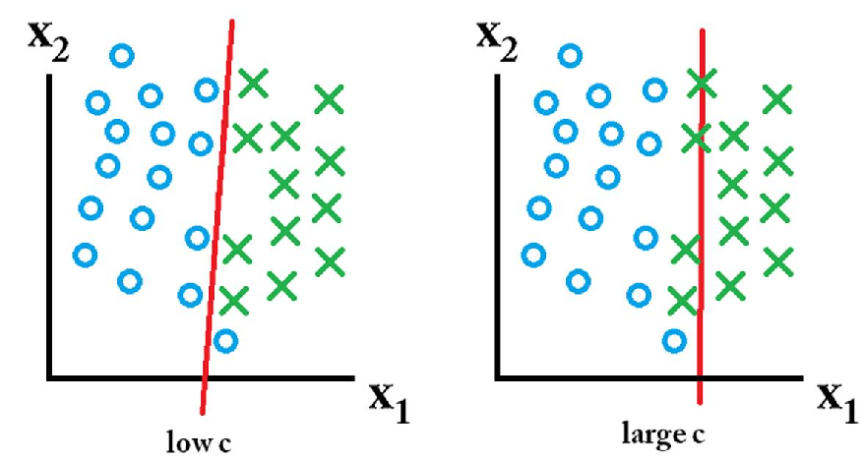
Testing
Regularization-c
Case I
Training
Classifier learned using a large C value is best.
Case II
Neglect it as error
Classifier learned using a low C value is best

Slide 35











Regularization - C
51
■ |  | classifier to
If | is | then Margin of
If | is | then Margin of
the data.
misclassification(possible)
■
→
■
→
Neglect it as error
The parameter C controls the trade-off between the smooth decision boundary
and classifying training points correctly.

Slide 36
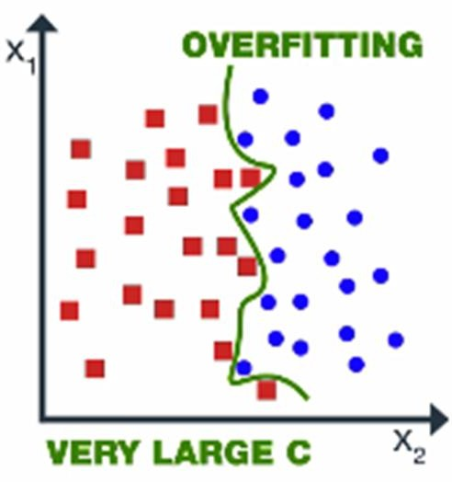














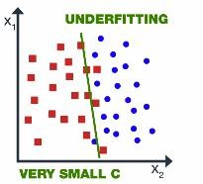










Regularization-C
52
If the value of
as a and
of
then model choose
and we get the
, which may
to the
.
If the value of choose
then model as a
and get
.

Slide 37









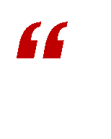



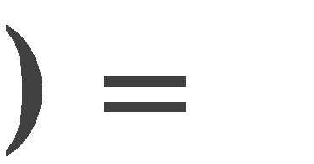

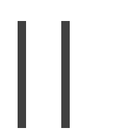

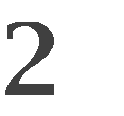













Gamma
54
Gamma is
.
an
. It is a
of the
In the
, it adjusts
γ
This is the equation of
.
Here γ is a
and known as
.
■

Slide 38








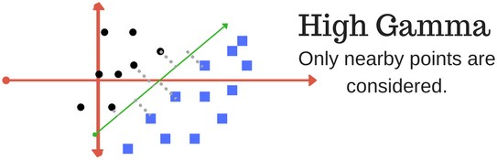
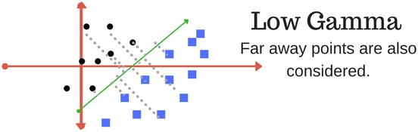
Gamma
55
Defines how far influences the calculation of plausible line of separation.
■
→ points
from are for
■
→ points
to
are
for

Slide 39



























Gamma
56
If the value of depend on points
, then our
will
to the than
and
due to which our
becomes more
.
متموج
If the value of
than
more a
, then and thus our
carry
becomes
is
.

Slide 40
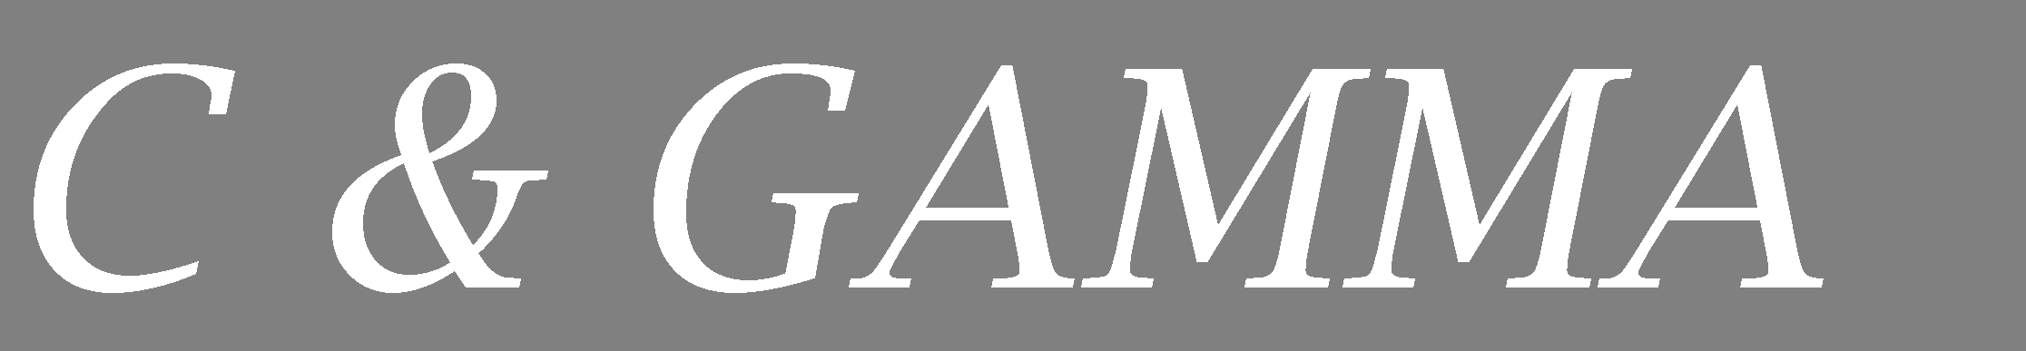
















57
The value of gamma and C should
be
because it
).
to the or it be very
(
Thus, we need to the order to get a .
of
in

Slide 41











ε-insensitive loss function
58
ε in be selected.
■
is the
of ε in the ε
should also
ε has an
on the
of the
■
The
so both the on its .
and the
of the network depend
Error Tolerance: It introduces a margin (ε) within which errors are ignored, preventing overfitting by not penalizing minor deviations.
Noise Robustness: By ignoring small errors, it reduces sensitivity to noise in the data, making the model more robust.

Slide 42

















What about multi-class SVMs?
59
Unfortunately, there is no “ ”
In practice, we have to obtain a
▪
■
: learn an SVM for each class vs. the others
: apply each SVM to test example and assign to it the class of the SVM that returns the highest decision value
■
▪
■
: learn an SVM for each pair of classes
: each learned SVM “votes” for a class to assign to the test example
■

Slide 43
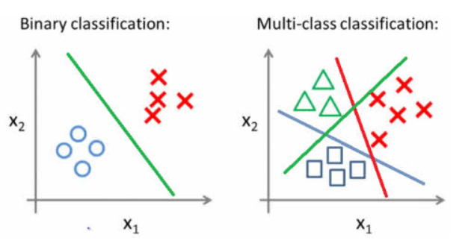
Multi-Class SVM ( One verses Other)
60

Slide 44
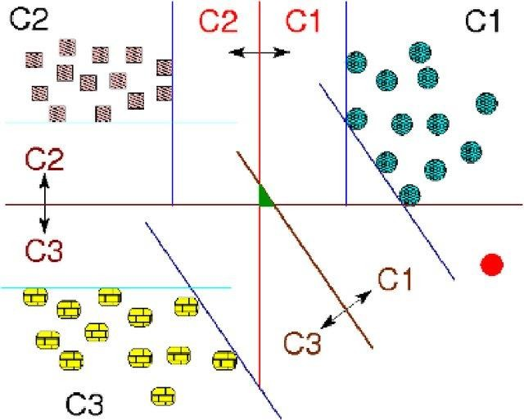
Multi-Class SVM ( One verses One)
61

Slide 45




















Pros
62
It works
It is
It is
with
in
spaces.
in cases where
.
points in the
is
than the
It uses a
(called support
vectors), so it is also .
Many publicly available SVM packages: http://www.kernel-machines.org/software
Kernel-based framework is very ,
SVMs work very well in practice, even with very

Slide 46
Cons
63
It doesn’t perform well, when we have large data set because the required training time is higher
No “direct” multi-class SVM, must combine two-class SVMs
Computation, memory
During training time, must compute matrix of kernel values for every pair of examples
Learning can take a very long time for large-scale problems

Slide 47






Applications of SVM
64
SVM has been used successfully in many real-world problems
(and hypertext)
■
■
(Protein classification, Cancer classification)
■

Slide 48






















Key points
65
Use to find solution (i.e., a
Seek separator to
) with
.
.
■
to make spaces
.
A support vector machine you to data
If it isn’t linearly separable, you can use the kernel trick to make it work.
SVM correctly the .
SVM will with .
■
.

